Slide 1
CUDA programming
软件学院 杨伟光
推荐配色
推荐字体：
微软雅黑
微软雅黑
宋 体
Arial Unicode MS
+
+

Slide 2
Menu
Programming Model
Execution Model
Memory Model
Streams
CUDA Libraries
Multi-GPU

Slide 3
Menu
CUDA Tools
How to learn CUDA

Slide 4
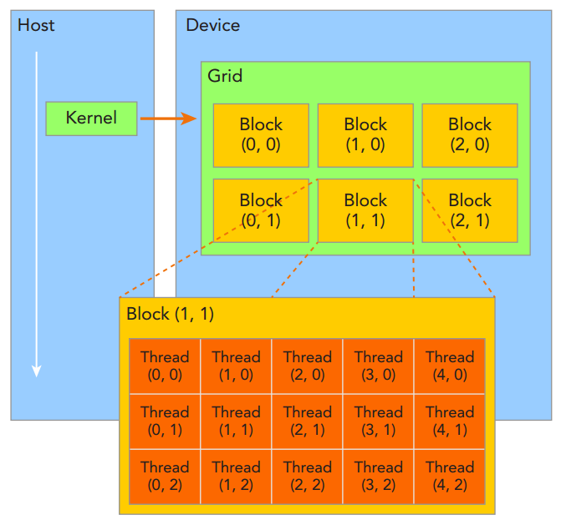
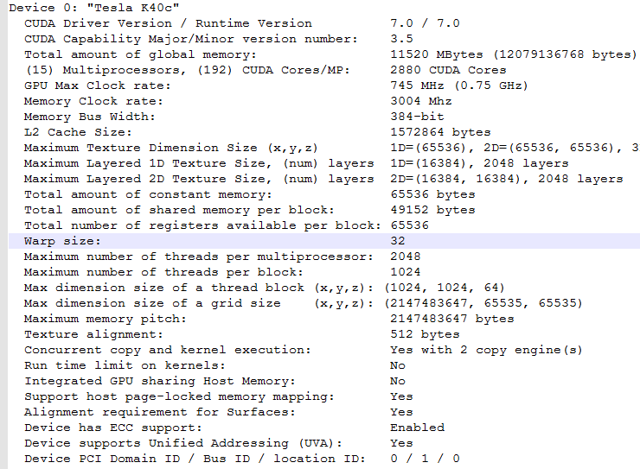
Programming Model
Grid: all threads in one kernel
Block: one grid including several blocks

Slide 5
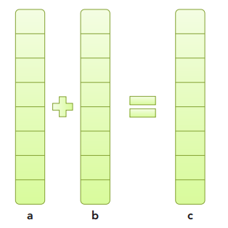
Programming Model
Example
vectorAdd
A typical processing flow of a CUDA program follows this pattern: 1. Copy data from CPU memory to GPU memory. 2. Invoke kernels to operate on the data stored in GPU memory. 3. Copy data back from GPU memory to CPU memory.

Slide 6
Programming Model
Timing Your Kernel
http://blog.csdn.net/litdaguang/article/details/50520549

Slide 7
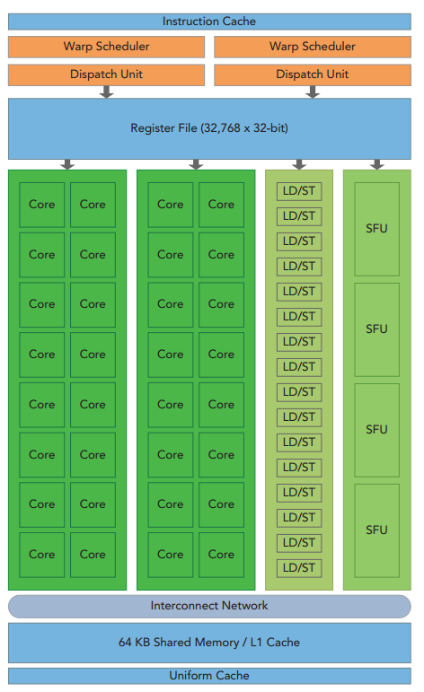
Execution Model
the key components of a SM: ➤ CUDA Cores ➤ Shared Memory/L1 Cache ➤ Register File ➤ Load/Store Units ➤ Special Function Units ➤ Warp Scheduler

Slide 8
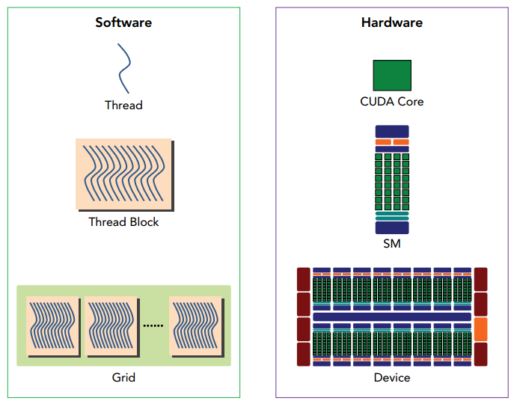
Execution Model
A thread block is scheduled on only one SM. Once a thread block is scheduled on an SM, it remains there until execution completes. An SM can hold more than one thread block at the same time.

Slide 9
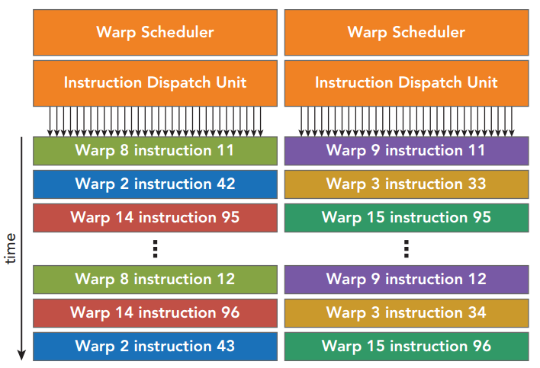
Execution Model
Out-of-order execution model
ready
stall
running
finish

Slide 10
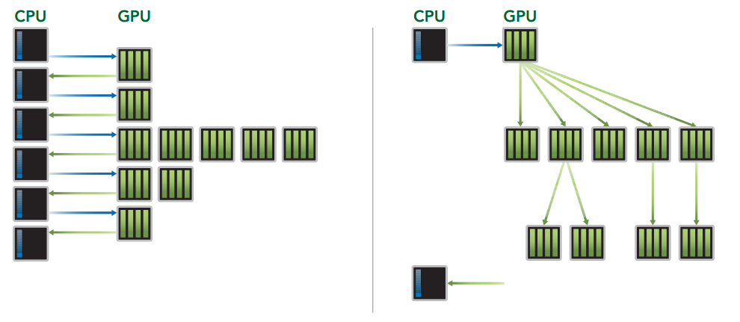
Execution Model
Dynamic Parallelism
Dynamic Parallelism is a new feature introduced with Kepler GPUs that allows the GPU to dynamically launch new grids.
/NVIDIA_CUDA-7.0_Samples/0_Simple/cdpSimpleQuicksort

Slide 11
Execution Model
线程1
线程2
线程3
线程4
Atomic Instruction
顺序访问方式
write
An atomic instruction performs a mathematical operation, but does so in a single uninterruptable operation with no interference from other threads.

Slide 12
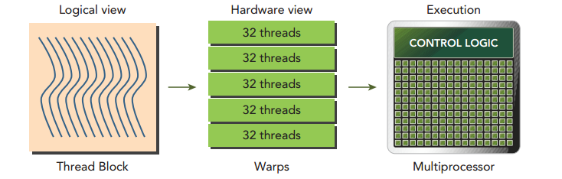
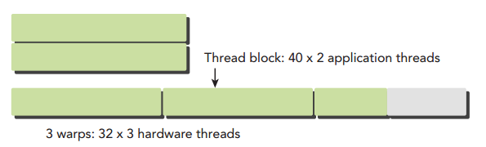
Execution Model
Each 32 threads in block organized into warp
warp is the execution unit in GPU

Slide 13
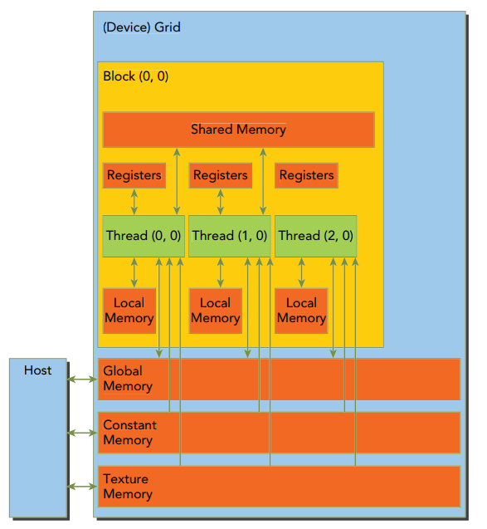
Memory Model
➤ Registers ➤ Shared memory ➤ Local memory ➤ Constant memory ➤ Texture memory ➤ Global memory
Onchip
Offchip

Slide 14
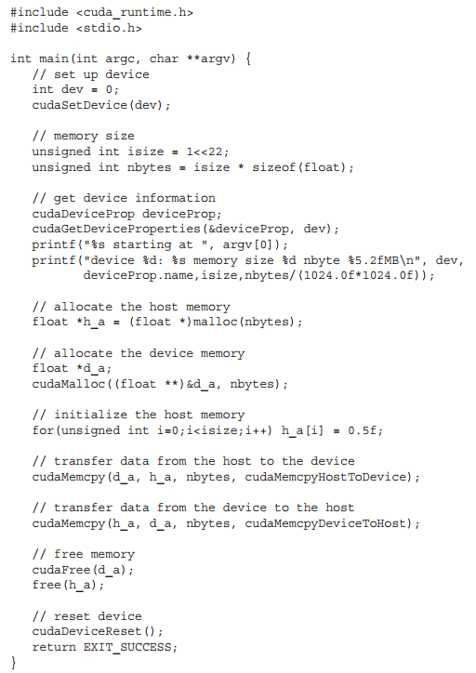

Memory Model
Global memory
Dynamic Global Memory:
➤ Allocate and deallocate device memory ➤ Transfer data between the host and device

Slide 15
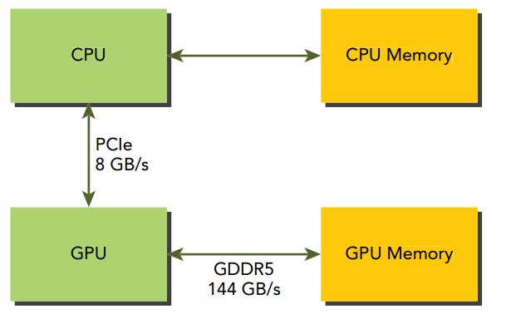
Memory Model
Global memory
Dynamic Global Memory:
PCIe Gen2
Fermi C2050 GPU

Slide 16
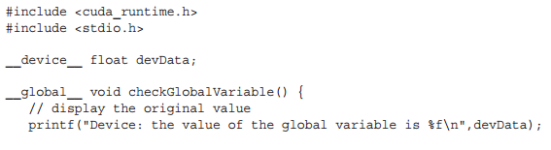
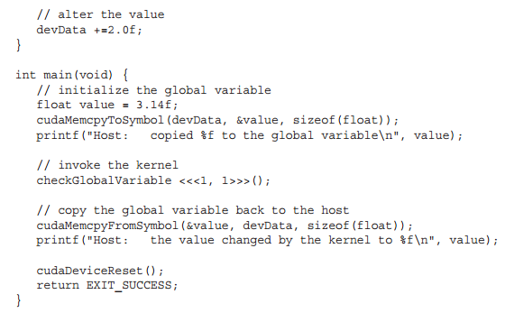
Memory Model
Global memory
Static Global Memory:

Slide 17
Memory Model

Slide 18
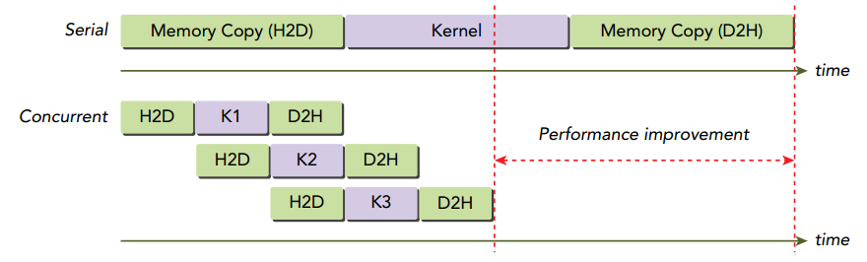
Streams

Slide 19
CUDA Libraries
https://cudazone.nvidia.cn/gpu-accelerated-libraries/

Slide 20
CUDA Tools
编辑器：
sublime text + cuda snippets 插件
Nsight Eclipse Edition
调试器：cuda-gdb，Nsight，CUDA-MEMCHECK
性能分析工具：NVIDIA Visual Profiler(NVVP)， nvprof
cuda docs (http://docs.nvidia.com/cuda/index.html)

Slide 21
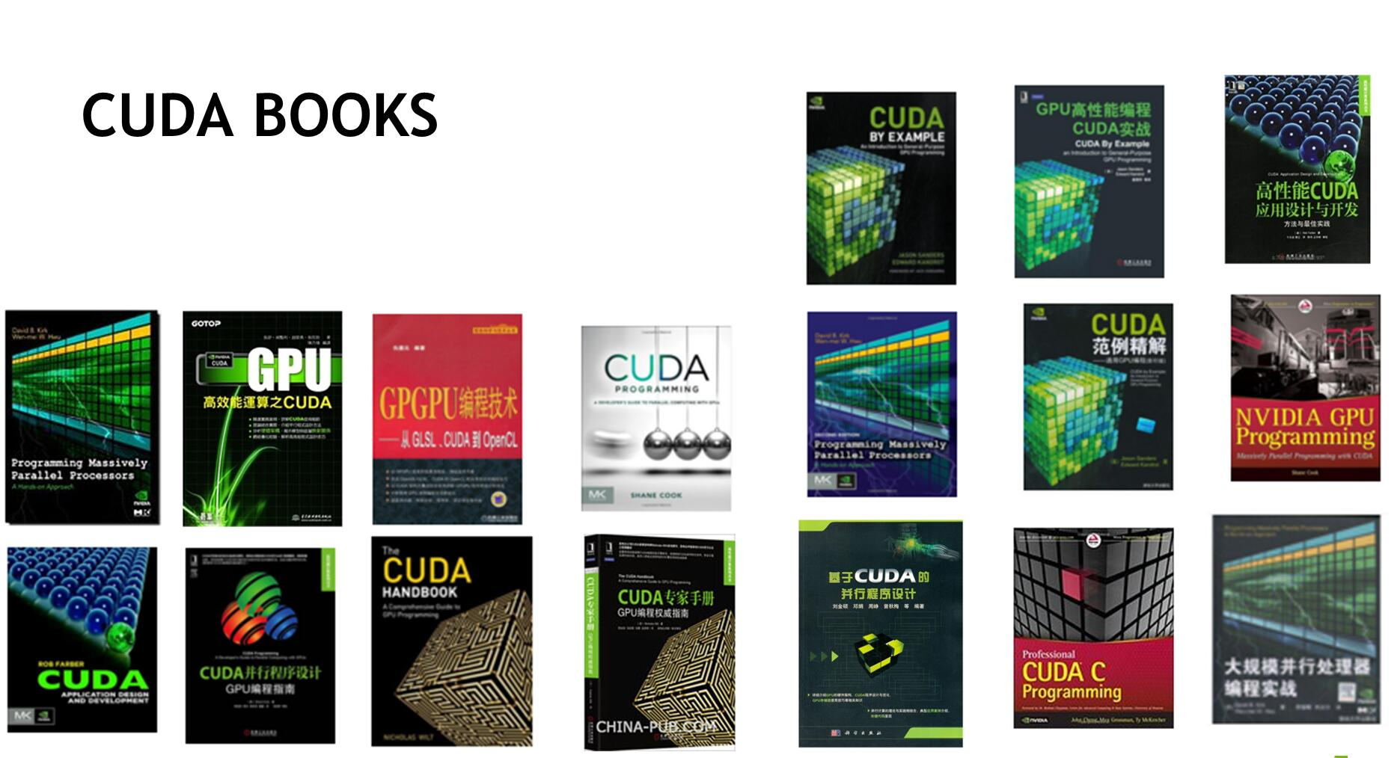
How to learn CUDA
官网入门文档：<<CUDA C Programming Guide>>
代码：cuda sdk example, openCUDA (https://github.com/LitLeo/OpenCUDA)
CUDA群：CUDA Professional (45157483)
Stack Overflow (http://stackoverflow.com/)
CUDA 书籍

Slide 22
Thanks

